Slide 1


New Client Portfolio Analysis
Group Members
Keiyana, Murthy, Ryan, Francene

Slide 2
1
6
Summary
Discussion
and Motivation
and Findings
CFAH Portfolio Managers
2
7
Investor Persona
Postmortem
Ralph Williams
We Killed It
3
8
Questions
Q&A
and Data
Open-floor
4
9
“I will tell you how to become rich. Close the doors. Be fearful when others are greedy. Be greedy when others are fearful.” — Warren Buffett
Data Cleanup
Bonus
and Exploration
SQL Postgres
10
5
Appendix
Data Analysis
References, Sources, Assumptions
and Charts

Slide 3
Summary and Motivation
We are investment consultants, and we are going to pitch a portfolio and risk analysis to a new client, Ralph Williams, to gain his business. To prepare a suitable investment strategy, we developed a portfolio that matches the investor. Through the discovery process, we focused on four key areas:
1
Investor Persona
3
Risk Profile
2
Time Horizon
4
Current Portfolio
We found that Mr. Williams had a complicated history with investing. His knowledge was limited, time horizon was long-term, and risk was moderate - confirmed by his existing portfolio. We used his existing portfolio of 2.3 million, but he also wanted us to invest an additional 1 million in fintech stocks. He gave us a list of the top ten stocks he heard about and asked that we choose the most suitable ones to compliment his portfolio.
Notes:
Define the core message or hypothesis Describe the questions you asked, and WHY you asked them Describe whether you were able to answer these questions to your satisfaction, and briefly summarize your findings.

Slide 4
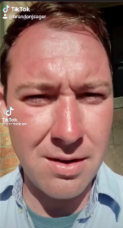







Investor Persona
43
Single
Ralph
Fintech
No kids
Williams
Trust
Drop-out
Fund

Slide 5

Questions and Data
Investor Profile Questionnaire
Time Horizon
Q1. I plan to begin withdrawing money from my investments in:
11 years or more (10 pts)
Q2. Once I begin withdrawing funds from my investments, I plan to spend all of the funds in:
11 years or more (11 pts)
*based on Charles Schwab Investor Profile Questionnaire

Slide 6

Questions and Data
Investor Profile Questionnaire
Risk Tolerance
Q3. I would describe my investment knowledge as:
Limited (3 pts)
Q4. When I invest my money, I am:
Most concerned about my investment gaining value (8 pts)
Q5. Select the investments you currently own:
Stocks and/or Stock funds (6 pts)
*based on Charles Schwab Investor Profile Questionnaire

Slide 7

Questions and Data
Investor Profile Questionnaire
Continued
Q6. In the past three months, the stock market lost 25% and you also lost 25% on a stock. What would you do? Nothing (5 pts)
Q7. Out of 5 worst/best case scenario's of 5 hypothetical Investment plans. Which one would you choose?
Average Annual Return, 10.4%, 33.6% best-case, -18.2% worst-case (6pts)
*based on Charles Schwab Investor Profile Questionnaire

Slide 8

Questions and Data
Investor Profile Questionnaire
Total = 24pts, Moderate
A moderate investment strategy MAY allocate cash in various categories but is not based on a forecast but reflecting an established approach to investing.
*based on Charles Schwab Investor Profile Questionnaire

Slide 9





Allocation Recommendations
International Equity
15%
Small-Cap Equity
10%
Large-Cap Equity
Cash
5%
35%
Fixed Income
35%
*based on Charles Schwab Investor Profile Questionnaire

Slide 10


Current Portfolio
International Equity
15%
Small-Cap Equity
10%
Large-Cap Equity
Cash
5%
35%
Fixed Income
35%
*provided allocation summary

Slide 11

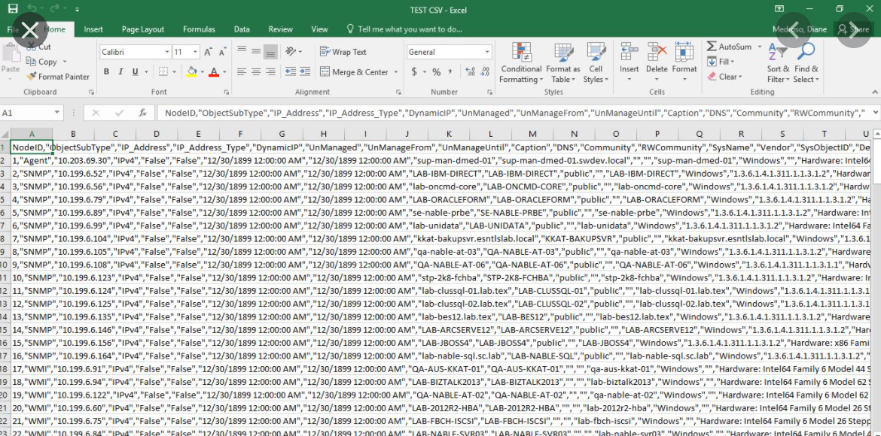
Data Clean-Up and Exploration
Initial Data Imports
The majority of our data came from Alpaca.api
Secondary research was complied and imported via .csv file
General Assumptions - We assume that data relied from third party sources such as alpaca and other data sources are accurate. We also assume that the plotting calculations and libraries used work as expected and any errors are due to the normal data constraints

Slide 12













Data to Analysis
Our Analysis Method
SIMULATIONS
ALPACA AND .CSV
DATA IMPORT
MODERATE PORTFOLIO
VS SP500
TOP 10
FINTECH
VS SP500
FINAL
RECOMMENDATIONS
DATA ANALYSIS BEGINS
DROP NULLS AND
REPLACED DEFAULT VALUES

Slide 13

Insights
Dear life, when I said “My day can't get any worse”, it was rhetorical not a challenge
Despite limited knowledge of investing, a moderate portfolio, and risk tolerance, Mr. Williams is trending toward a moderately aggressive investor. A re-evaluation of his risk profile will be necessary next year.
Problems
Technically we had issues with our data due to limited practice with PyPortfolioOpt the new python library and working on branches and merging within github.
With troubleshooting our issues were resolved.
Notes:
Discuss any difficulties that arose, and how you dealt with them. Additional python library challenges, installing and implementing. Discuss any additional questions that came up, but which you didn't expect to answer. What would you research next, if you had two more weeks?

Slide 14
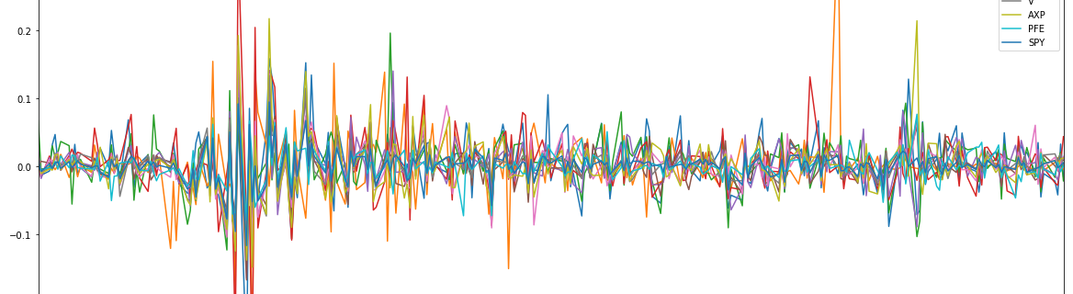
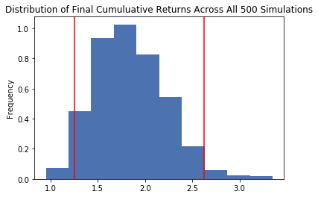
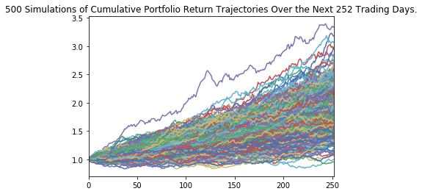

Slide 15





Libraries and Dependencies
os
numpy
pandas
Alpaca.api
MCForecastTools
plotly
panel
hvplot
pypfopt

Slide 16
Data Analysis
Simulations, Tools and Techniques
Daily Returns
Sharp Ratios
Measuring percentage change
Assessing performance
Cumulative Returns
Distribution
Measuring total change over time
Describing all the possible values and likelihoods
Monte Carlo Simulations
Co-variance
Predicting the probability of different outcomes
Measuring the directional relationship between the returns
Betas
Variance
Measuring volatility and systematic risk
How much risk and profitability

Slide 17







Conclusions
“I don't jump to conclusions, I cannonball them like a boss .”
Unknown (probably Jacob again)
Betas and Sharp Ratios confirmed that the top Fintech stocks that would compliment Mr. Willams Portfolio were MELI, SQ, CDOT, PYPL.
The Monte Carlo top ten Fintech they outperformed estimated returns and it was a 95% would gain between 21 and 165%. With the minimum being a 5% increase in returns.
While the SP500 would loose 42% or gain %145 minimum loss of 56%

Slide 18

Discussion
“After a long and heated discussion... the toaster and I agreed I'm not crazy.” Unknown (probably Jacob)
What conclusions have we made?
What were our findings?
What conclusions have we made?
What can we infer?

Slide 19
Postmortem. What would we research next?

Slide 20

Questions?
Notes:
Open floor Q&A

Slide 21
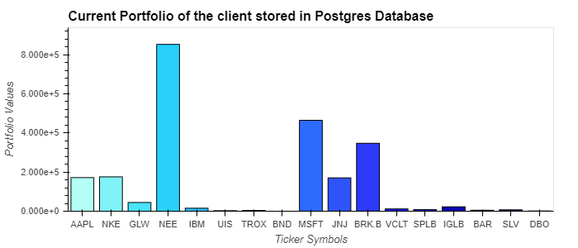
SQL Postgres
CURRENT PORTFOLIO BAR PLOT USING POSTGRES SQL DATA

